Slide 1
Luke 18:9-17
(English Standard Version)
2 Slides

Slide 2
⁹ He also told this parable to some who trusted in themselves that they were righteous, and treated others with contempt: ¹⁰ “Two men went up into the temple to pray, one a Pharisee and the other a tax collector. ¹¹ The Pharisee, standing by himself, prayed thus: ‘God, I thank you that I am not like other men, extortioners, unjust, adulterers, or even like this tax collector. ¹² I fast twice a week; I give tithes of all that I get.’ ¹³ But the tax collector, standing far off, would not even lift up his eyes to heaven, but beat his breast, saying, ‘God, be merciful to me, a sinner!’ ¹⁴ I tell you, this man went down to his house justified, rather than the other. For everyone who exalts himself will be humbled, but the one who humbles himself will be exalted.”

Slide 3
¹⁵ Now they were bringing even infants to him that he might touch them. And when the disciples saw it, they rebuked them. ¹⁶ But Jesus called them to him, saying, “Let the children come to me, and do not hinder them, for to such belongs the kingdom of God. ¹⁷ Truly, I say to you, whoever does not receive the kingdom of God like a child shall not enter it.”

Slide 4
The Kingdom, and Humble, Dependent Faith
Self-righteous attitude. 1. A hindrance to Salvation (being saved)
The Gospel is offensive because it is a message that I am a sinner in need of a Saviour
“Sin is the Rejection of God”. To deny the need of a saviour is to sin.
2. A hindrance to Prayer
^{James 5:16}... The Prayer of a righteous man is powerful and effective.
The “righteous man” is the one who humbly confesses his sin.
The Pharisee
Devoutly committed to good morals and the keeping of God’s Law
Prayed about himself. “I am wonderful and righteous”.
Saw sin in others, but not in himself.
The Tax Collector
A profession known for their greed and for working with the enemy.

Slide 5
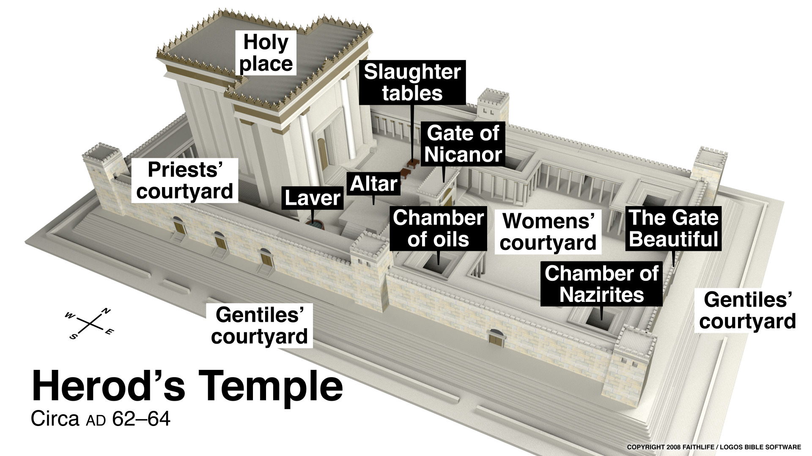

Slide 6
The Kingdom, and Humble, Dependent Faith
The Pharisee
Devoutly committed to good morals and the keeping of God’s Law
Prayed about himself. “I am wonderful and righteous”.
Saw sin in others, but not in himself.
The Tax Collector
A profession known for their greed and for working with the enemy.
Stood far off. Aware of sin – felt unworthy to come into the presence of Holy God.
“God, be merciful to me, a sinner.”
1. Salvation (being saved)
The self-righteous deny their need of a Saviour. Therefore not saved.
Those who feel totally unworthy, cry out to God for mercy.
Atoning mercy. Jesus died to pay the penalty of our sins.
When we humbly confess our sin and ask for mercy, we will be “justified” (acquitted).
2. Humble Prayer
Christian prayer requires bold humility.
Sometimes we have a distorted view of ourselves.
Too low of a view (Fail to grasp our holiness through forgiveness); or
Too high of a view (“I am righteous and others are sinners”.)
As an infant is totally dependent on its parents,
we are totally dependent on our Heavenly Father.

